Slide 1
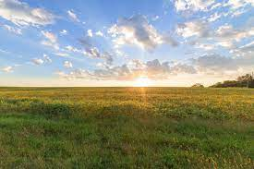

Slide 2
Introduction
Agriculture plays an important role in the economy of the world; the entire world depends on agriculture for survival. This is attributed to the fact agriculture serves as a source of the basic human needs.
Over the years, there has been an increase in the demand for agricultural production especially considering the increase in the world’s population and the need to provide food security in different parts of the world.

Slide 3
Objective
The main objective of this project is to reduce the time and money the farmers spare on irrigation.

Slide 4
Problem identification
To provide efficient decision support system using wireless sensors network which handle different activities of farm and gives useful information related to soil moisture, Temperature and Humidity
content. Due to the weather condition, water level increasing Farmers get lot of distractions which is not good for Agriculture.

Slide 5
Proposed system
It is a network of different devices which make a self-configuring network. The new developments of Smart Farming with use of IoT, by day turning the face of conventional agriculture methods by not only making it optimal but also making it cost efficient for farmers and reducing crop wastage

Slide 6

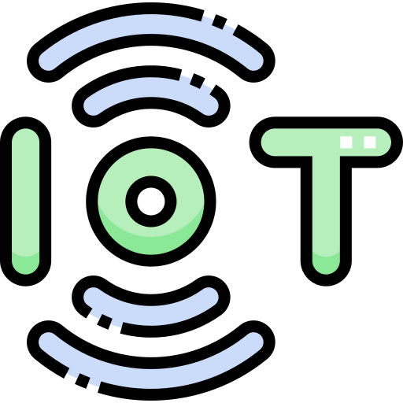


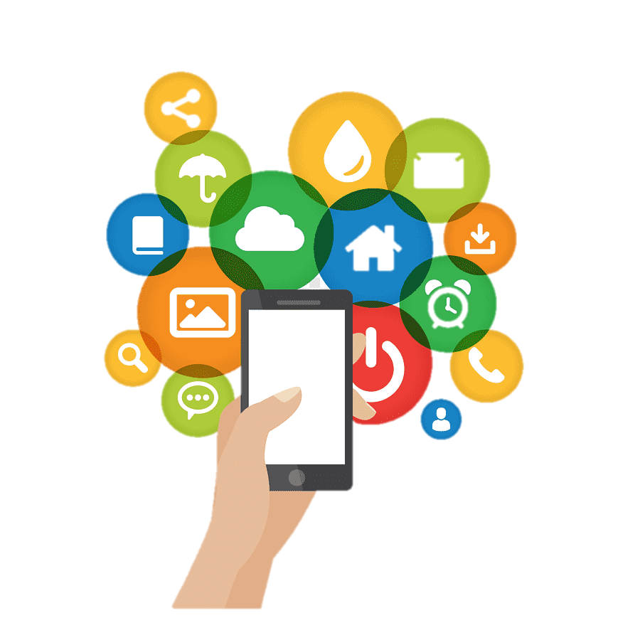

Block Diagram
IoT Device
IBM Watson
IoT Platform
Web Application
Mobile Application
User

Slide 7
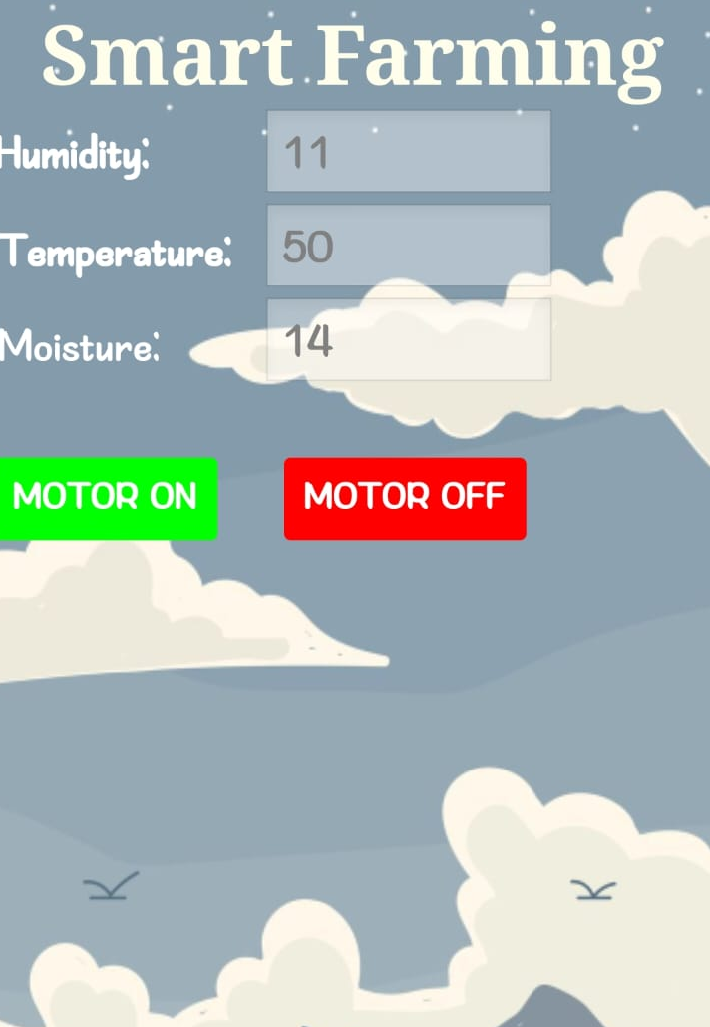
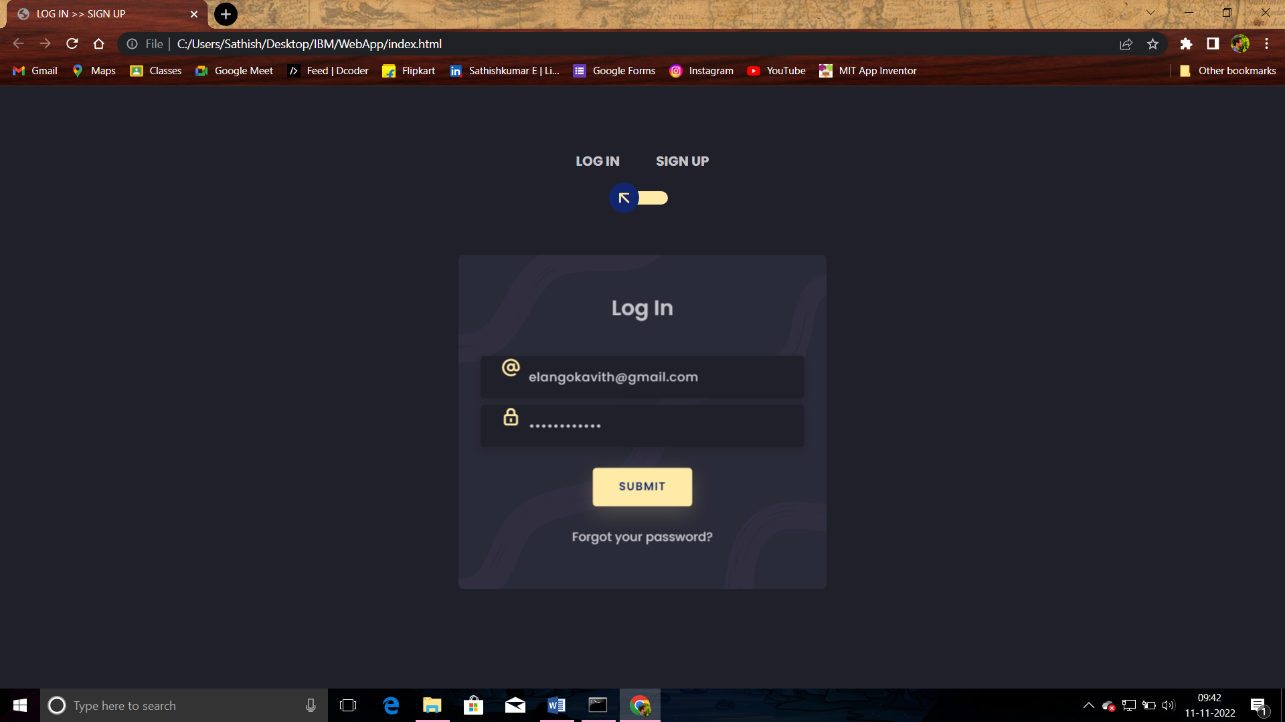
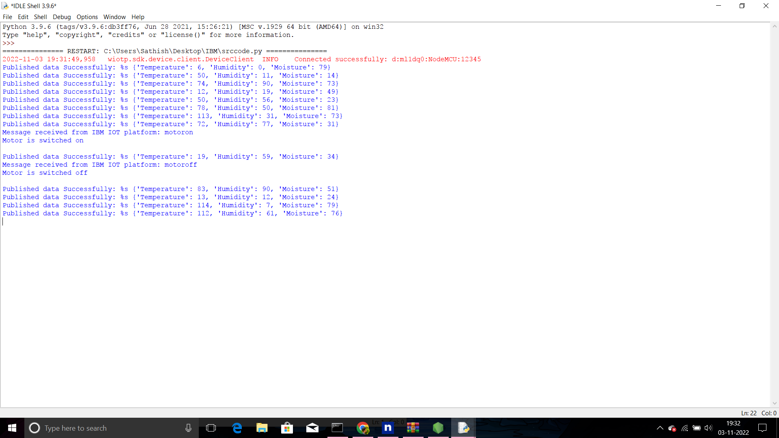
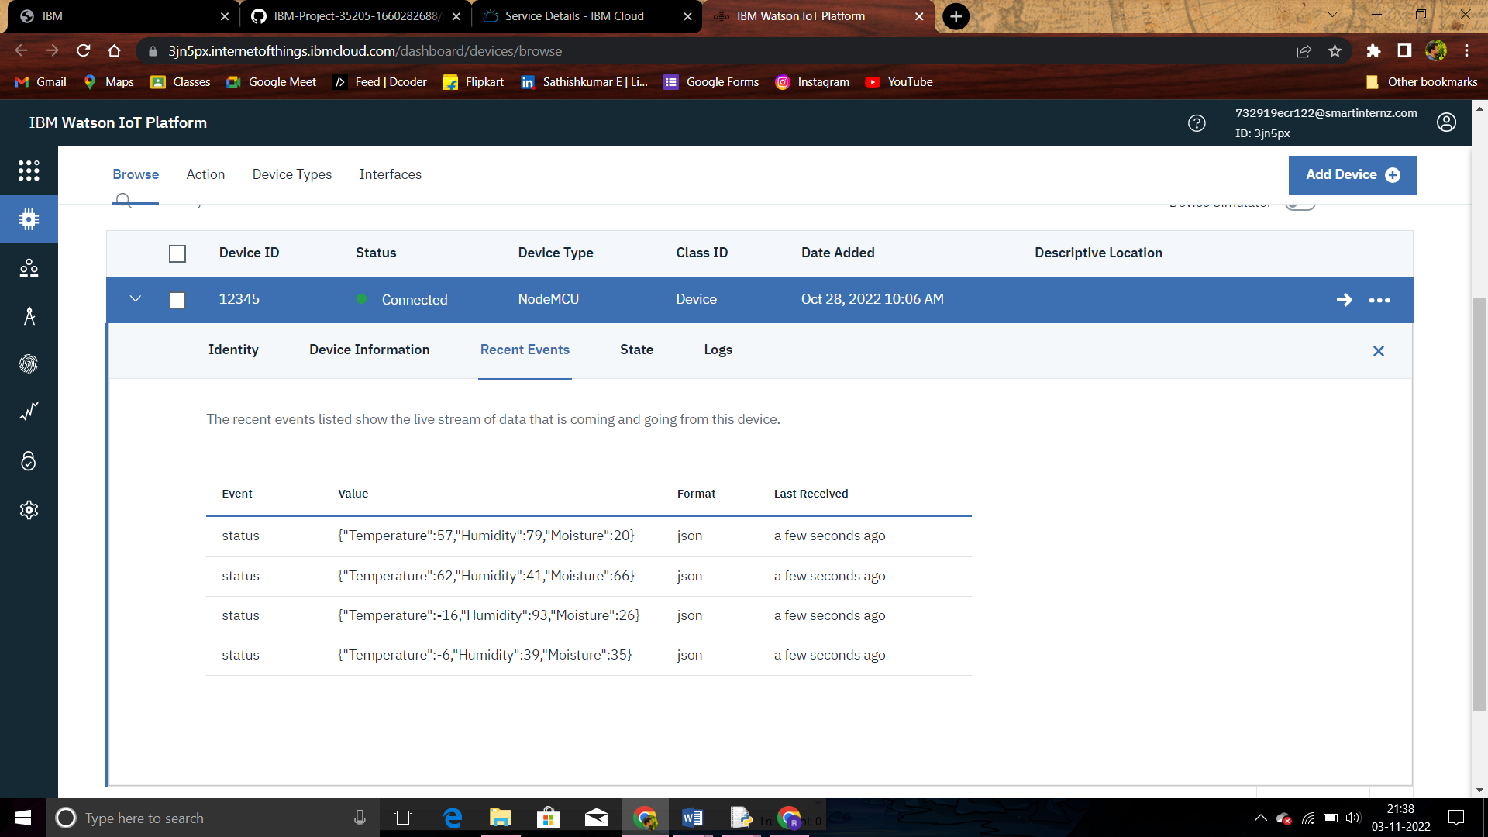
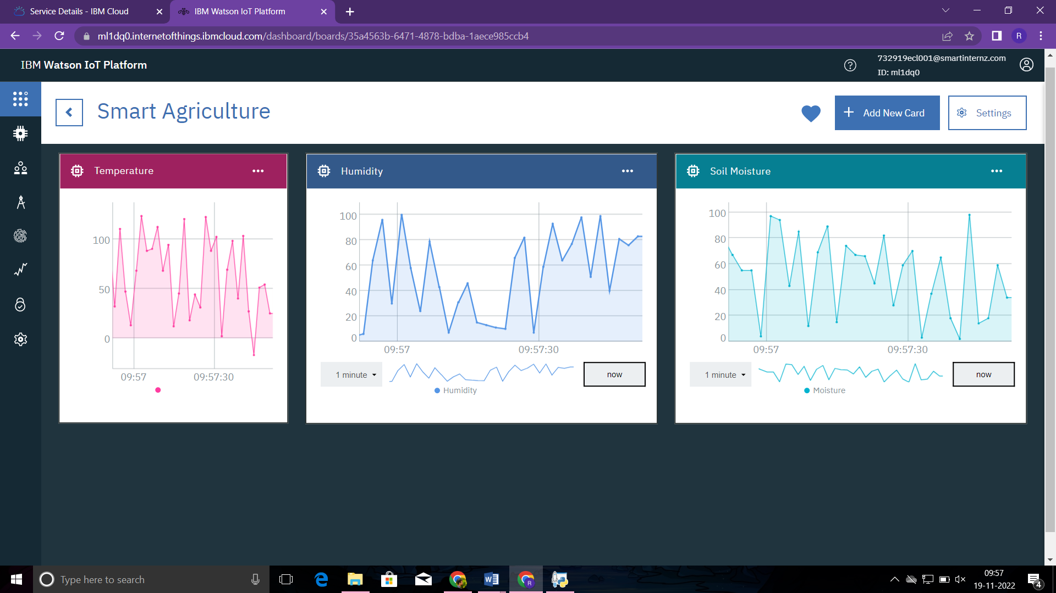
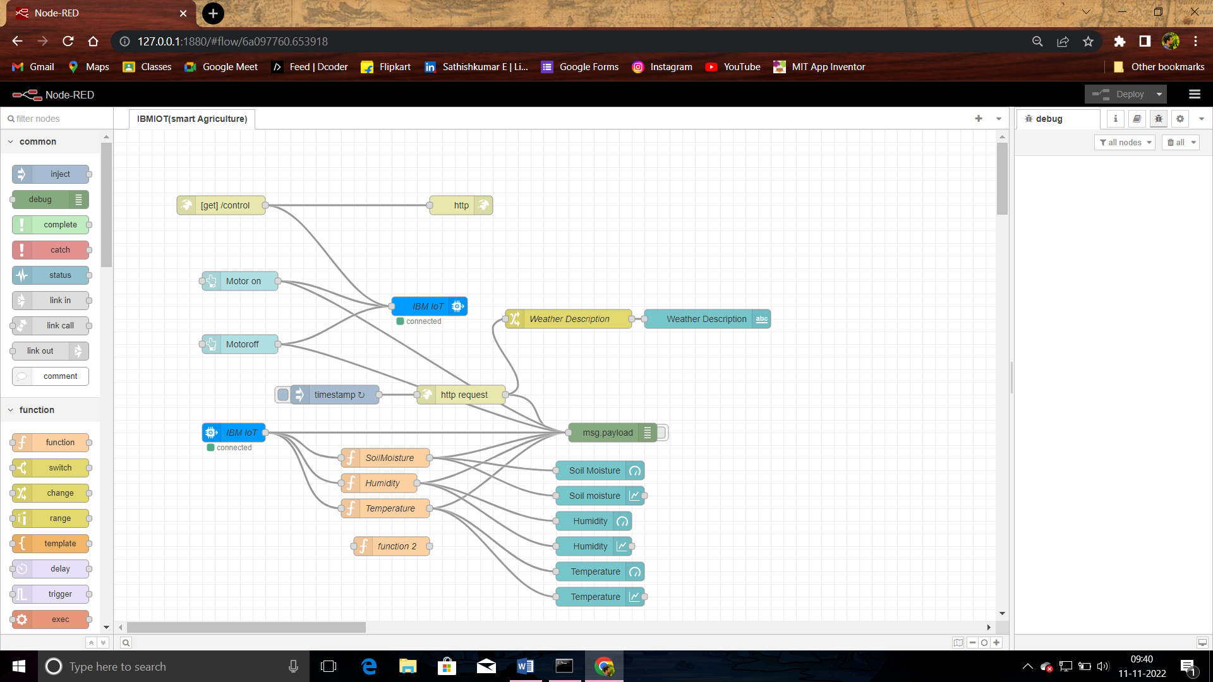
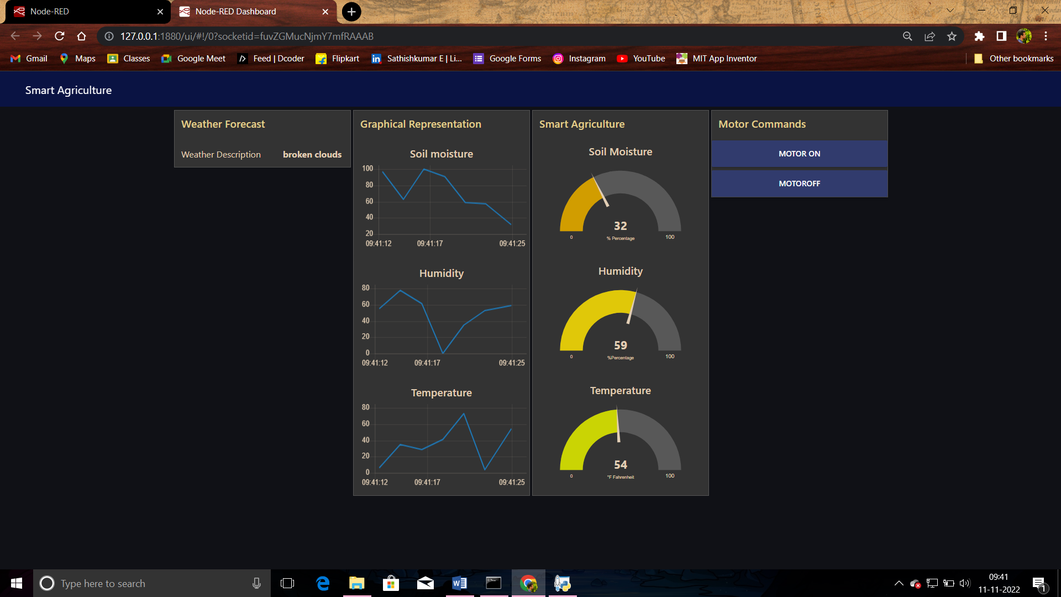
Activities

Slide 8
Advantages
● All the data like climatic conditions and changes in them, soil or crop
conditions everything can be easily monitored.
● Risk of crop damage can be lowered to a greater extent.
● Many difficult challenges can be avoided making the process automated and the
quality of crops can be maintained.
● The process included in farming can be controlled using the web applications
from anywhere, anytime.
Disadvantages
● Smart Agriculture requires internet connectivity continuously, but rural parts can
not fulfill this requirement.
● Any faults in the sensors can cause great loss in the agriculture, due to wrong records
and the actions of automated processes.
● IoT devices need much money to implement.

Slide 9
Applications
● Precision Farming that is farming processes can be made more controlled and
accurate.
● Live monitoring can be done of all the processes and the conditions on the
agricultural field.
● All the controls can be made just on the click.
● Quality can be maintained

Slide 10
THANK YOU

